Slide 1
Artificial intelligence Based Product Rating system for Kibo customer

Slide 2

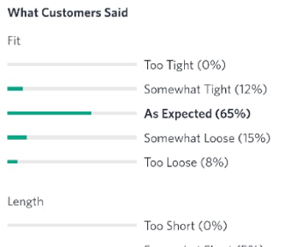
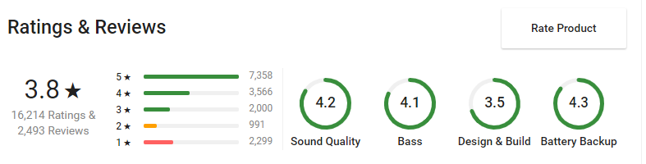
Artificial intelligence Based Product Rating system by using Customer Review for Kibo customer

Slide 3
Introduction
On the basis of customer comments/review we will provide better insights of product and give better Rating
Example : For a shoes we have a overall rating of the product but if we give rating based on the comfort ,thickness, style .people will be more clear about the product and chances of their buying a product and not returning both will increase due to clarity we have provided.
Once we have categorical Rating and analysis than it can also be used for recommending in better way.
We use rating to recommend also
Example : A person who wants to have comfortable shoes will be suggested those shoes which are having highest customer rating in comfort.
In sorting Instead of giving option like price ,popularilty we can give comfort

Slide 4
Problem
Problem: Ratings are good but they can be misleading and may cause loss of important insight
A customer might have rated negative but actually commented positive things
A customer might have rated positive but actually commented negative things
A customer might have rated good but has informed about the flaws in the comment which will be missed
Although comfort is an issue but This product is really value for money
A customer who has rated less might have added some valuable remarks which will be missed
This product is bad . Expect comfort everything is bad

Slide 5
Task to do
Dividing sentence to lines and than applying sentiment analysis or them
In the search page : add a column for searching by category
In the product page : add a widget to show the rating
In the delivery completed page: add a feedback page
Integrating everything .

